Slide 1
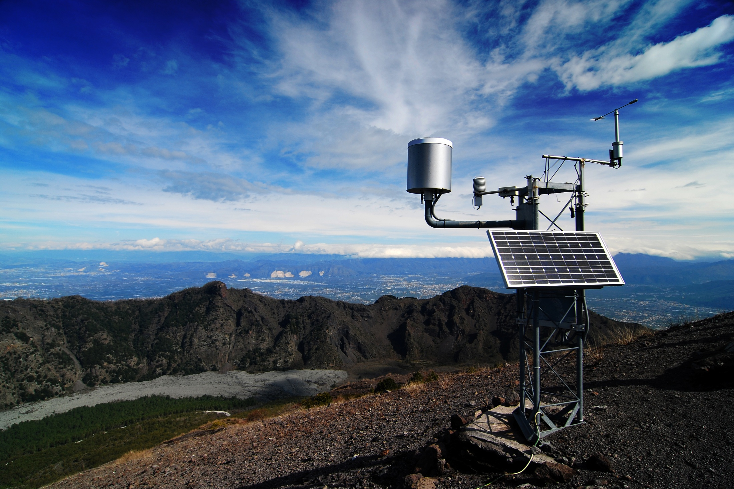
Smart Weather Station

Slide 2
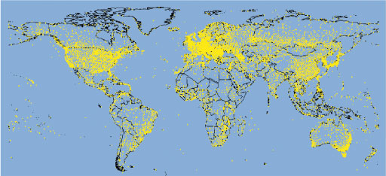
Problem Abundance of weather data, but uneven coverage
Weather stations that release daily data worldwide, on land (both staffed and automatic) and at sea (on ships and buoys), circa 2007. [ Source: The Open University (https://www.open.edu/openlearn/ocw/mod/oucontent/view.php?id=13661&printable=1) ]

Slide 3
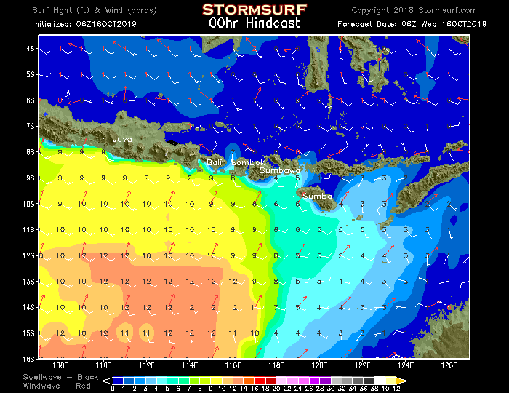
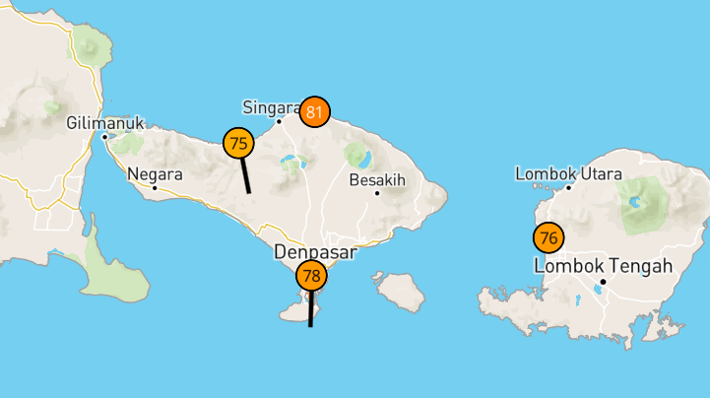
Problem (cont’d) Some local weather patterns differ from observations/predictions about their wider surroundings
Only 3 weather stations on Bali have data available on Weather Underground website. [ Source: https://www.wunderground.com/wundermap?lat=-8.65&lon=115.22&zoom=8&pin=&rad=1&rad.type=00Q&wxsn=0&svr=0&cams=0&sat=0&riv=0&mm=0&hur=0 ]
Example surf report for Bali and surrounds. [ Source: Stormsurf website (http://www.stormsurf.com/locals/bali.shtml) ]

Slide 4
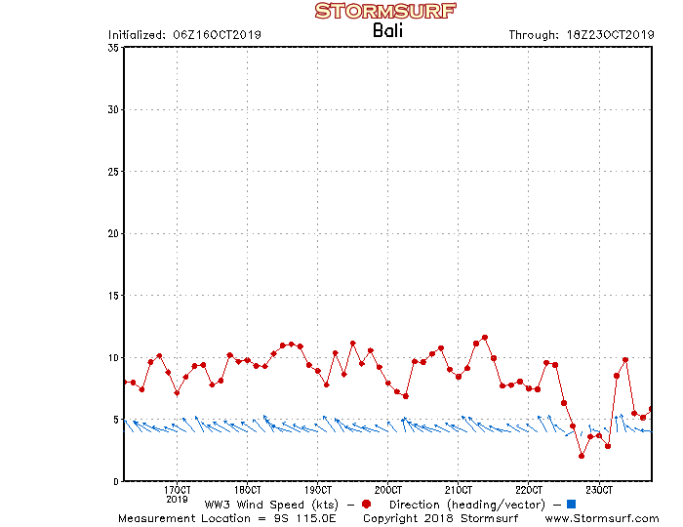
Problem (cont’d) Some areas have diurnal, seasonal, and unpredictable variations in weather patterns (e.g. wind speed & direction)
Example wind speed and direction predictions over a 7-day period at an unnamed location on Bali. [ Source: Stormsurf website (http://www.stormsurfing.com/cgi/display2.cgi?a=t10;b=bali_wnd) ]

Slide 5
Problem (cont’d) Where real-time weather data not available for a remote location of interest at the time/s of interest …
How do we obtain such data remotely?
Why? To improve planning for weather-dependent activities such as:
Surf sports
Hiking through tough terrain
Construction projects
Controlled burning
…
Better planning = time and effort saved e.g. not driving a long distance to a beach

Slide 6
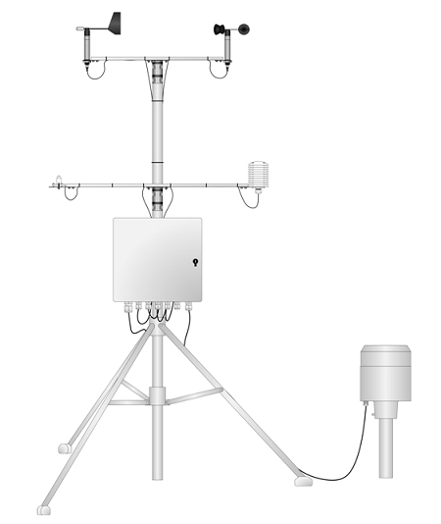
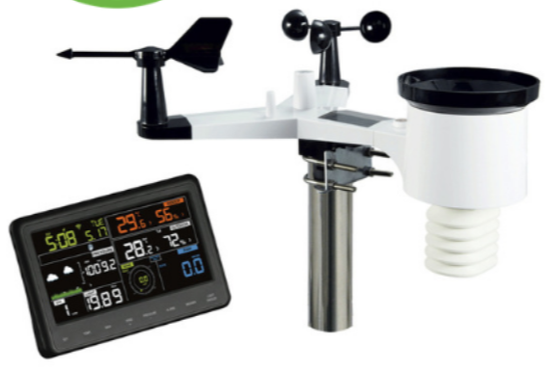
Existing Solutions Range greatly in pricing and functionality
Cheaper systems tend to be targeted for on-premises use, unable to connect to remote location
More professional-oriented system ($14,000+)
[ Source: https://www.instrumentchoice.com.au/instrument-choice/weather-stations/proffesional-weather-stations/weather-station-engineer-ic-weathereng ]
Consumer-oriented system ($300+)
[ Source: https://www.instrumentchoice.com.au/instrument-choice/weather-stations/proffesional-weather-stations#products ]

Slide 7
Our Proposed Solution & Objectives
An Internet-connected, small-scale, personal weather station that could compete with existing offerings on cost and features
Cheap(er) to build and operate
Easy to deploy
Operates reliably
Weather-proof (water-proof)
Low-profile appearance
Battery-powered with solar energy harvesting
RF connectivity

Slide 8
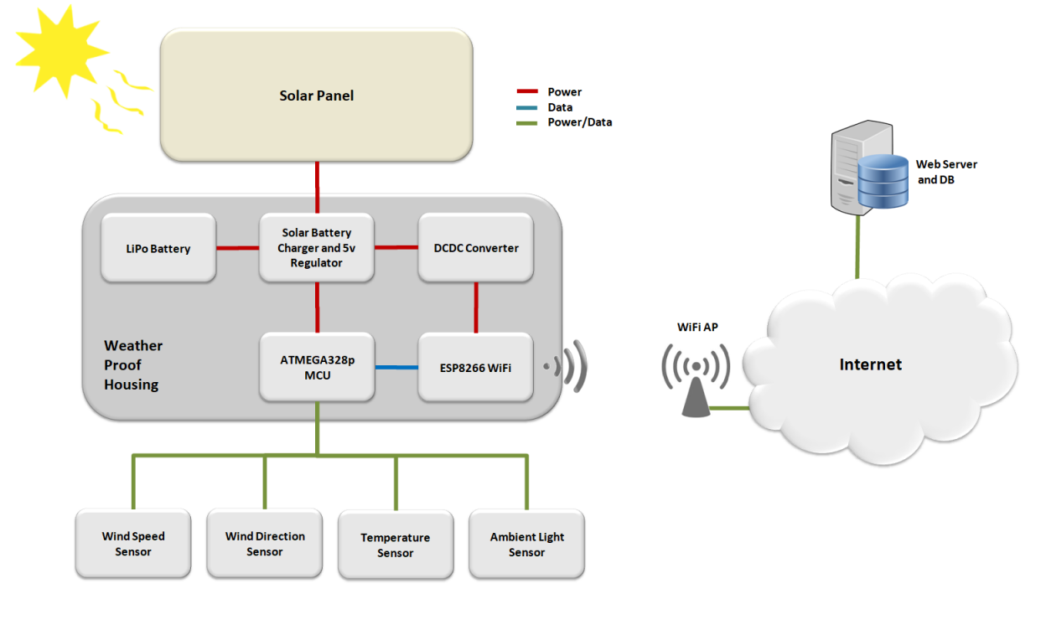
System Description

Slide 9
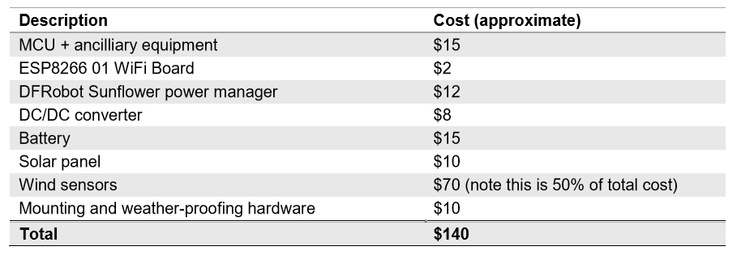
Hardware & Cost

Slide 10
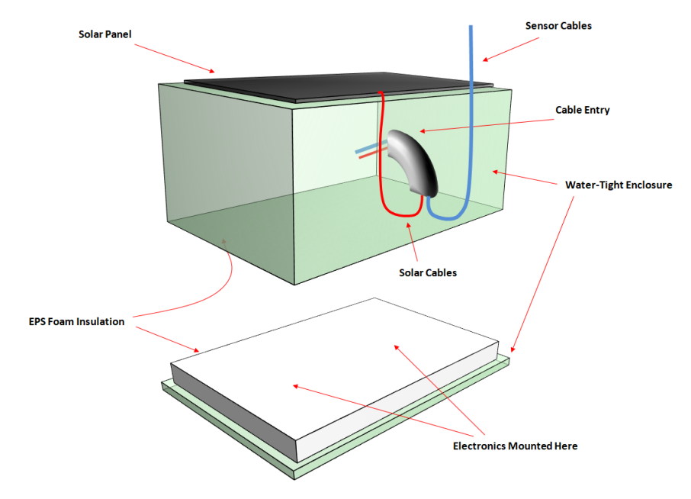
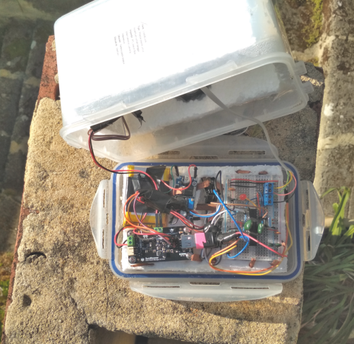
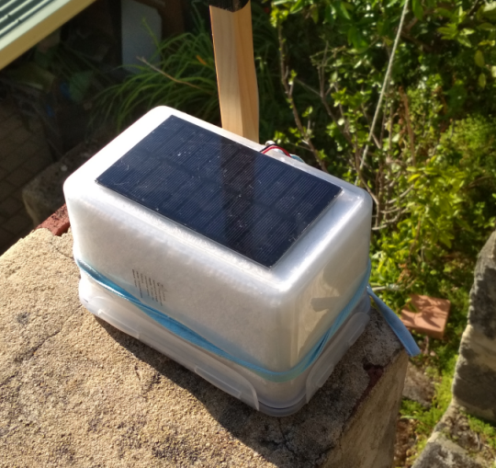
Enclosure

Slide 11
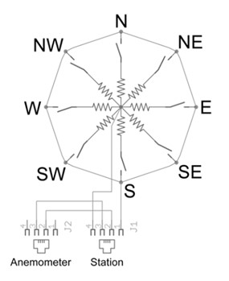

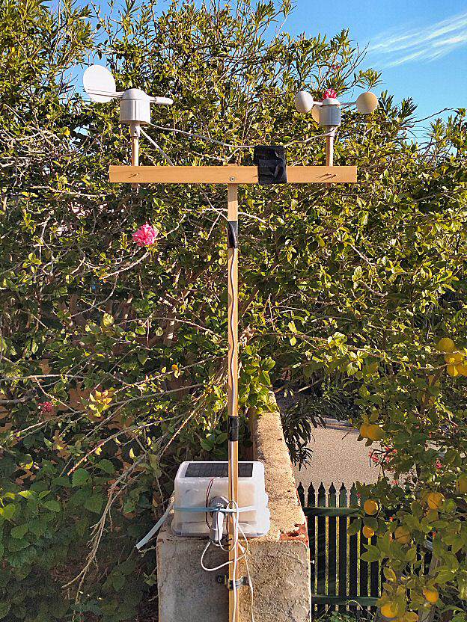
Wind Sensor & Frame

Slide 12
Backend System

Slide 13
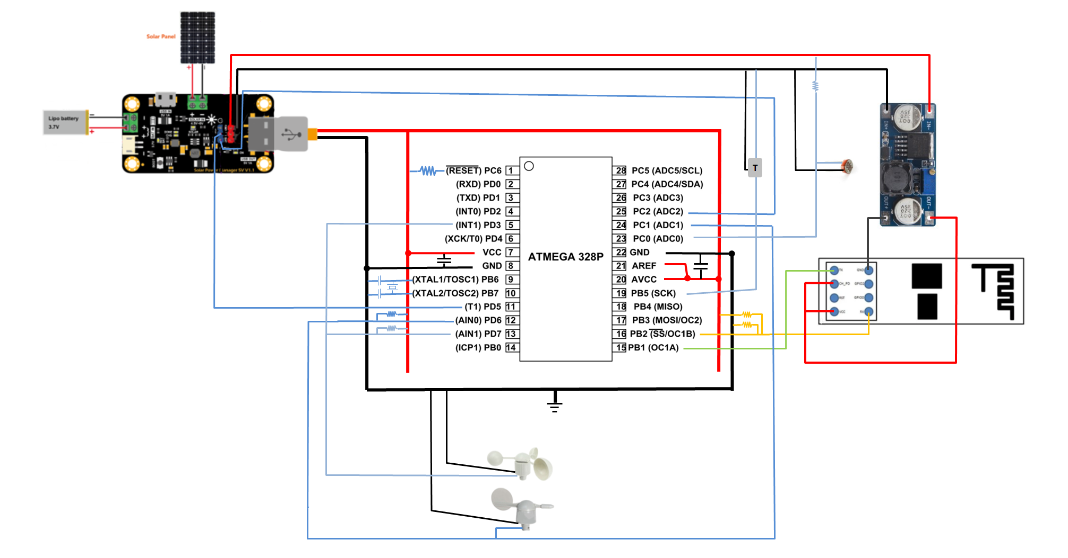
Electronics – Schematic

Slide 14
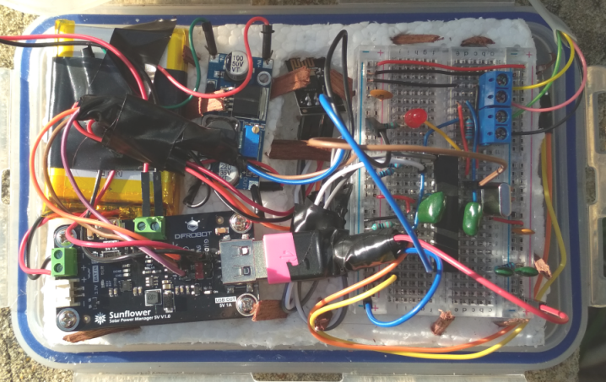
Electronics - Whole

Slide 15
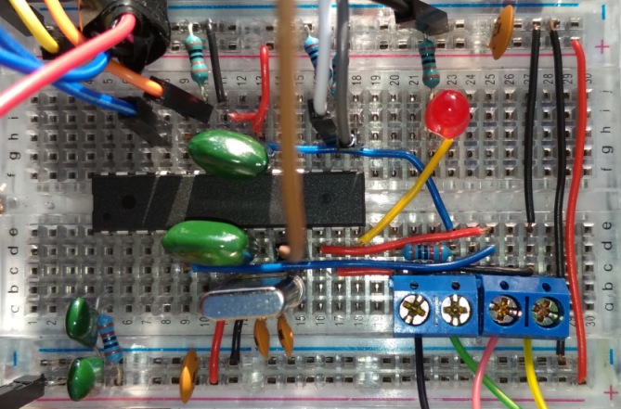
Electronics - Breadboard

Slide 16
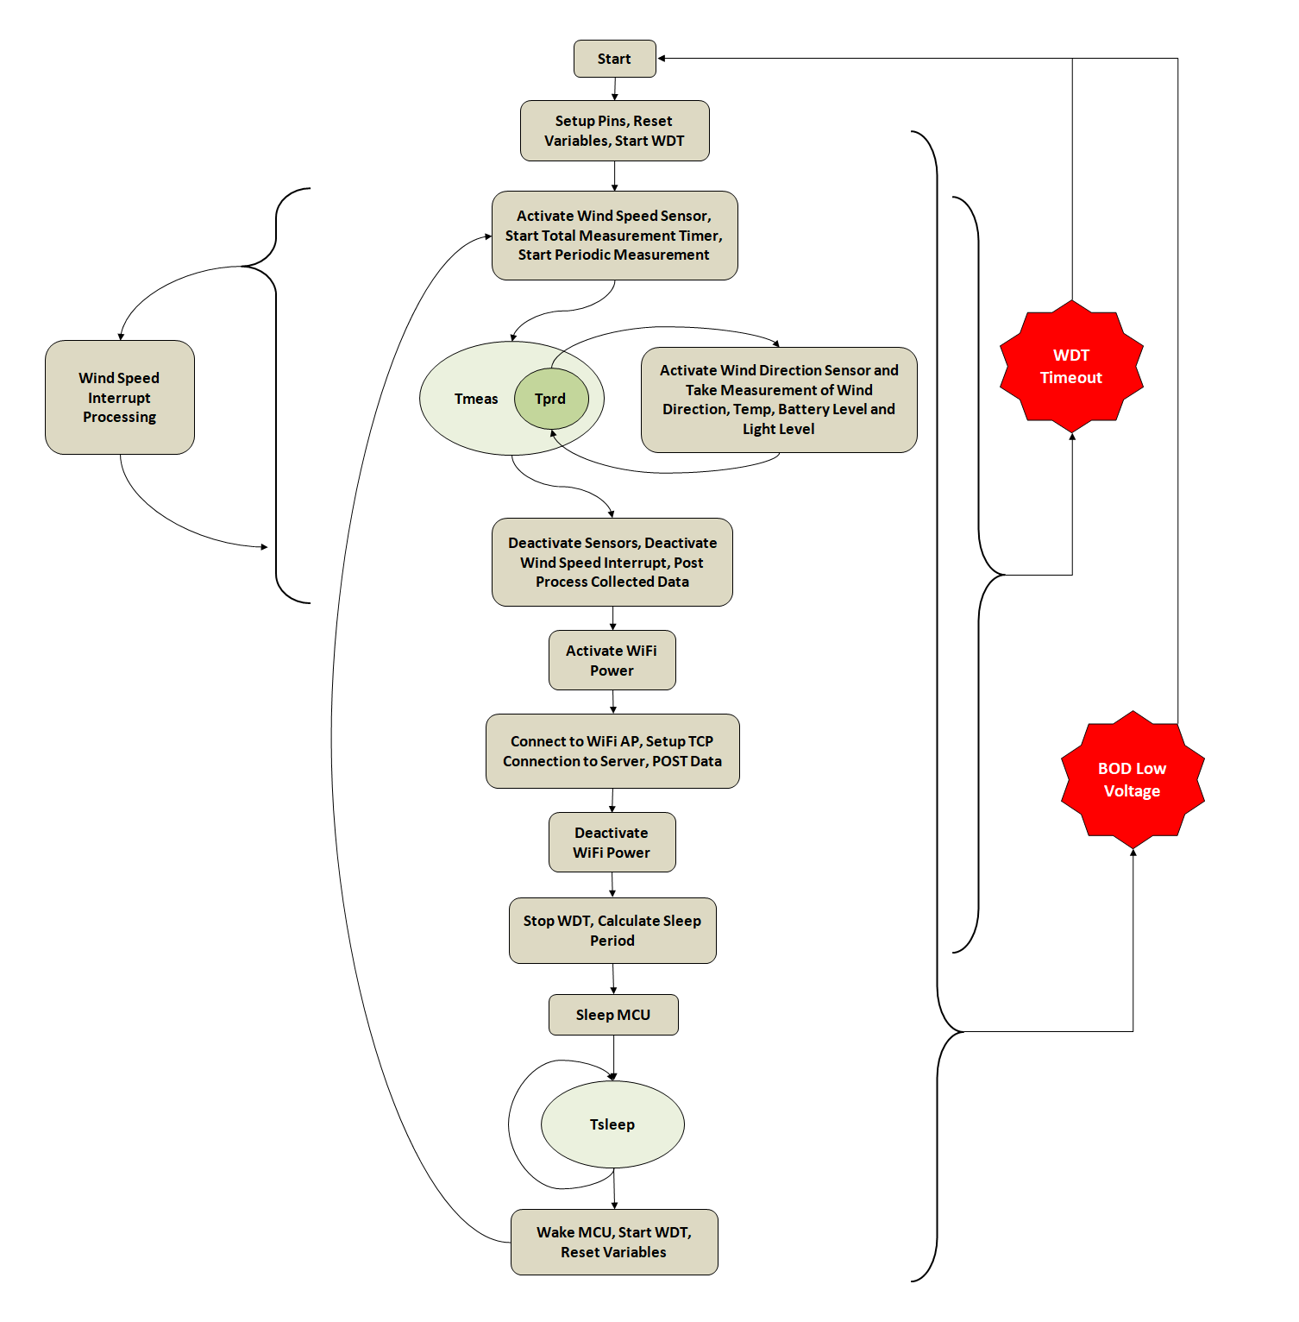
Software MCU

Slide 17
Software – Web Server
Server Hardware – Raspberry Pi
Server Software – Flask Application
Database – sqlite3

Slide 18
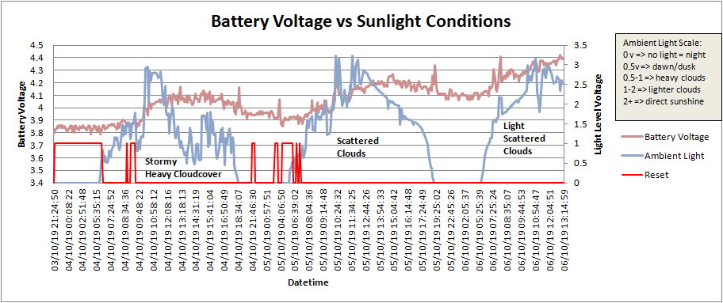
Results – Power Harvesting

Slide 19
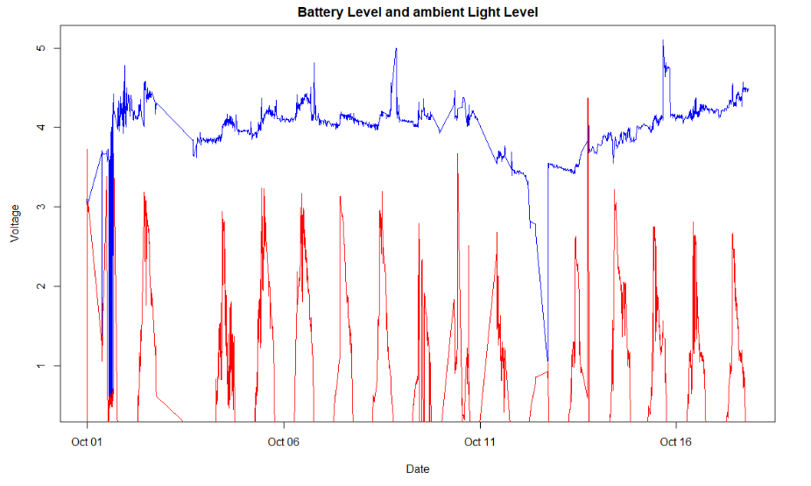
Results – Power Harvesting

Slide 20
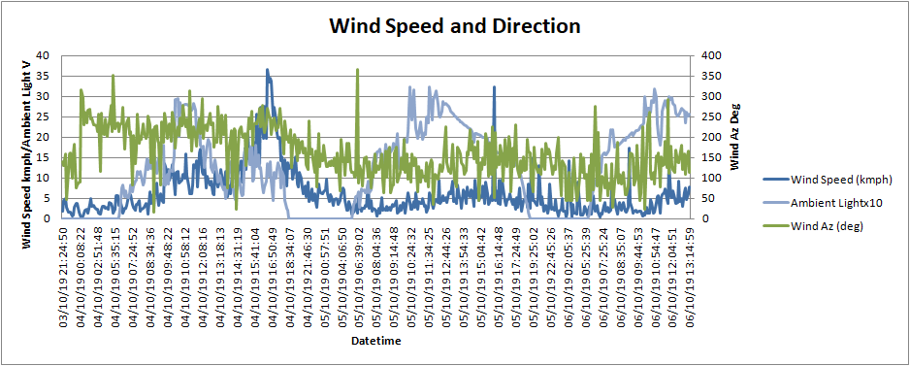
Results – Weather Data

Slide 21
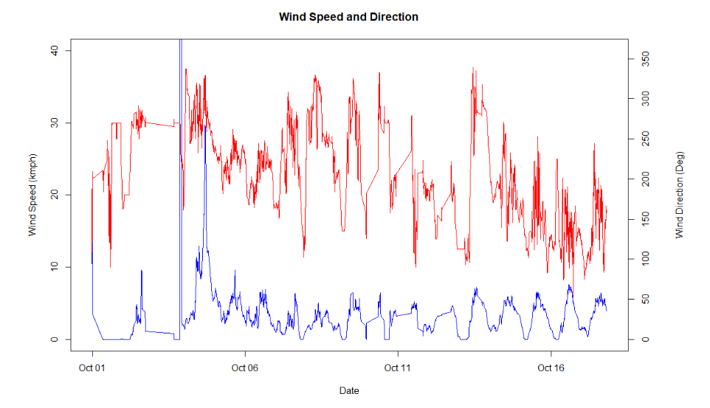
Results – Weather Data

Slide 22
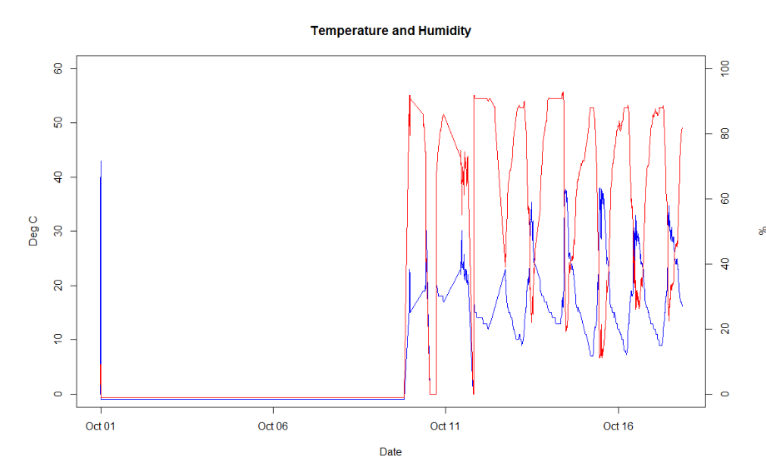
Results – Weather Data

Slide 23
Room for Improvement
Replace WiFi with cellular technology
Cost and power will be challenging
Simplify design into a single Printed Circuit Board, or a kit that customers can self-assemble
Interactive user interface with options for displaying and analysing collected data
Alerts via email/SMS/IM when weather conditions meet pre-set requirements
Use the base technologies developed (weather-proof enclosure, power self-sufficiency) in other IoT devices for outdoor/remote use e.g. surveillance system

